Slide 1
Estimating Traffic Flow Rate on Freeways from Probe Vehicle Data and Fundamental Diagram
Khairul Anuar (PhD Candidate)
Dr. Filmon Habtemichael
Dr. Mecit Cetin (presenter)
Transportation Research Institute
Old Dominion University

Slide 2
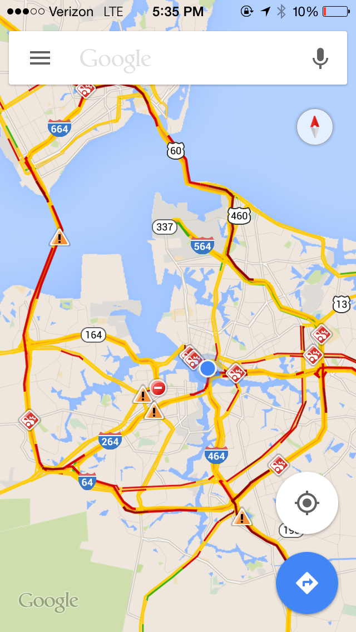
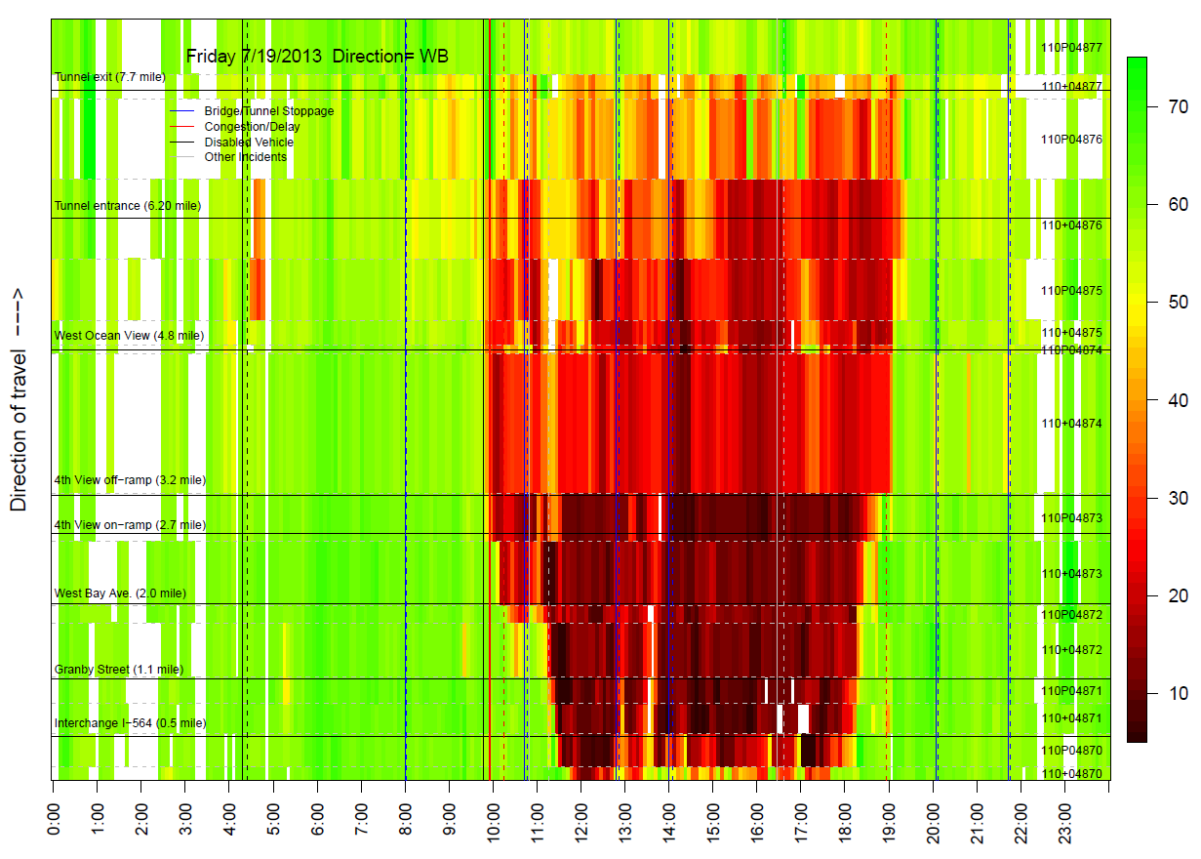

Slide 3
Introduction
Point sensors
Aggregate data: Flow, speed, occupancy
Relatively high cost
Probe data
Individual vehicle trajectories (but data providers aggregate)
Sample size might be small
Relatively low cost
Goal: Estimate traffic flow rate from raw probe data

Slide 4
Literature Review
Flow estimation
Estimation of flow and density using probe vehicles with spacing measurement equipment (Seo et al, 2015)
Deriving traffic volumes from PV data using a fundamental diagram approach (Neumann et al, 2013)
Traffic states (queue length, travel time)
Real time traffic states estimation on arterial based on trajectory data (Hiribarren and Herrera, 2014)

Slide 5
Objectives
Estimate traffic flow on freeways from PV data and fundamental diagram
Unique from previous studies
Four different FDs
Aggregation intervals of 5, 10 and 15 minutes

Slide 6
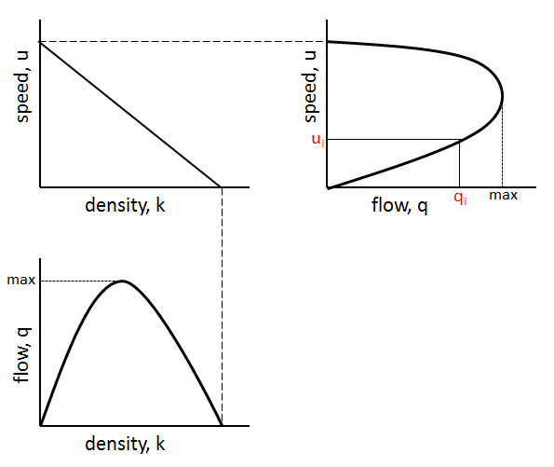
Methodology
From FD estimate flow q when speed u is known
u is probe vehicle speed

Slide 7
Methodology
Four different models of fundamental diagram
Model | Speed-Density Relationship | Regression
Greenshield | $$k=k_{j}\left(1−\frac{u}{u_{f}}\right)$$ | $$k=k_{j}−\frac{k_{j}}{u_{f}}u$$
Underwood | $$k=k_{o}\ln\left(\frac{u_{f}}{u}\right)$$ | $$k=k_{o}\ln{u_{f}}−k_{o}\ln{u}$$
Northwestern | $$k=k_{o}{\left(2\ln{\frac{u_{f}}{u}}\right)}^{1/2}$$ | $$k^{2}=2k_{o}^{2}\ln{u_{f}}−2k_{o}^{2}\ln{u}$$
Van Aerde | $$k=\frac{1}{c_{1}+\frac{c_{2}}{u_{f}−u}+c_{3}u}$$ | $n=\frac{2u_{c}−u_{f}}{{\left(u_{f}−u_{c}\right)}^{2}}$ ,$c_{2}=\frac{1}{k_{j}\left(n+1/{u_{f}}\right)}$ , $c_{1}=nc_{2}$, $$c_{3}=\frac{{−c}_{1}+\frac{u_{c}}{q_{c}}−\frac{c_{2}}{u_{f}−u_{c}}}{u_{c}}$$

Slide 8
Methodology
Performance indicators
$${PE}_{i}=\frac{F_{i}−O_{i}}{O_{i}}×100\%$$
$$MAPE=\frac{1}{n}\sum_{i=1}^{n}{\left|\frac{F_{i}−O_{i}}{O_{i}}\right|}×100\%$$
$$RMSE=\frac{1}{n}\sqrt{n\sum_{i=1}^{n}{{\left(F_{i}−O_{i}\right)}^{2}}}$$
F_{i} is the i^{th} estimate value
O_{i} is the i^{th} observe value
n is the number of samples

Slide 9
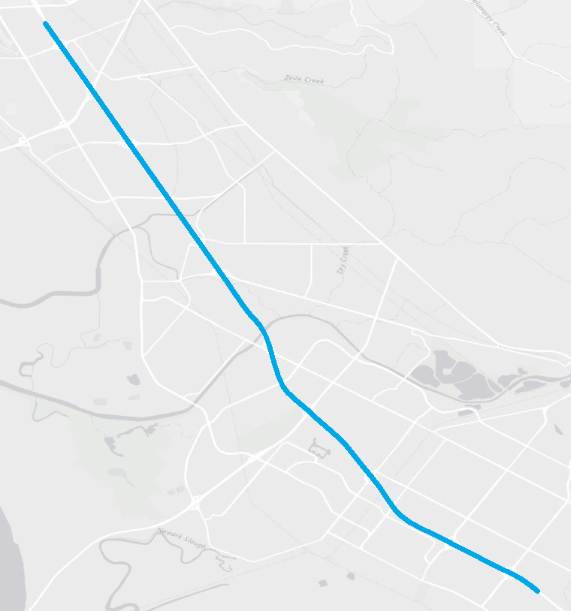
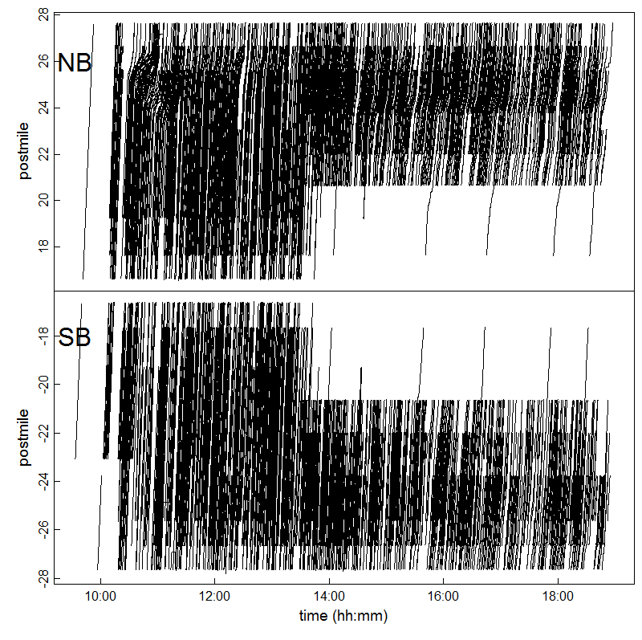
Case Study
Mobile Century (I-880 SF Bay area)
Study site
Probe vehicle trajectory
Length: 12 mile
SB
Due to known recurring congestion, NB is analyzed
NB
Notes:
One day, Friday Feb 8, 2008. 165 drivers. GPS-enabled cell phones which on average transmitted data every 3 seconds. The penetration rate of PV is in the range of 2-5% depending on time of the day.

Slide 10
Field Data
Probe
Collected by 165 drivers on Friday Feb 8, 2008
2-5% of total traffic
GPS points @ 3-sec on average
Loop
Speed-flow data aggregated by 5-minute intervals for about one month

Slide 11
Speeds

Slide 12
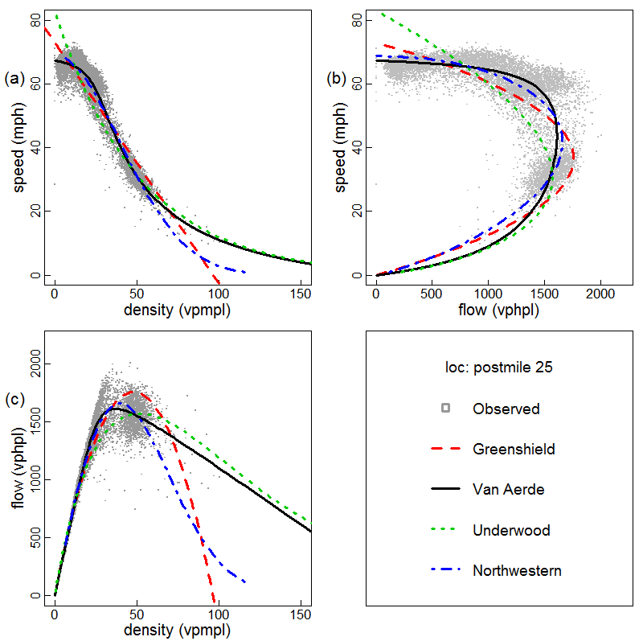
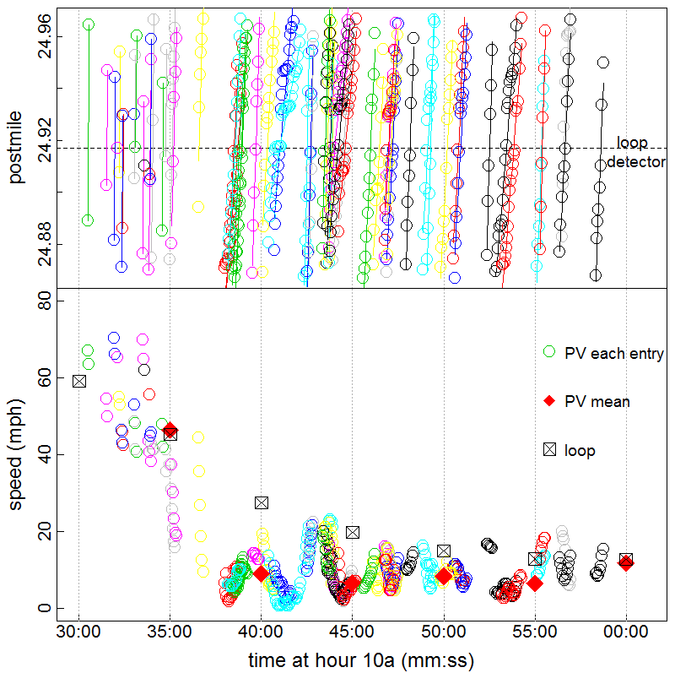
Case Study
Fundamental diagram
Loop vs PV speed

Slide 13
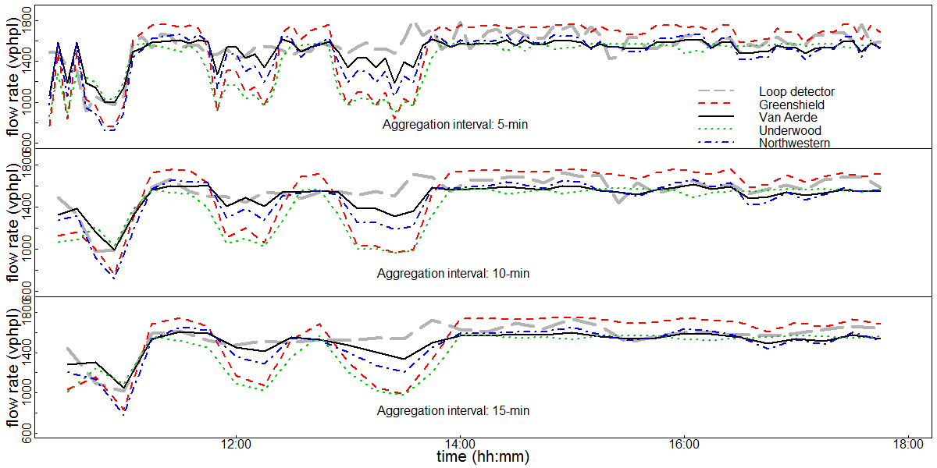
Results
Comparison of loop detector and estimated flow from fundamental diagram

Slide 14
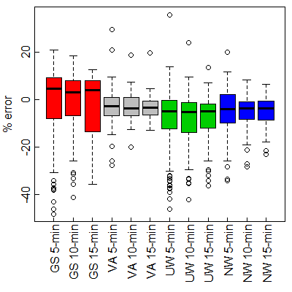
Results
Distribution of percentage error for different FDs and aggregation intervals
FD models | Aggregation interval | MAPE (abs %) | RMSE (vphpl) | Avg. Error | Std. Dev.
Greenshield | 5-min | 12.5 | 189 | -2.1 | 17.1
 | 10-min | 11.1 | 169 | -2.2 | 15.2
 | 15-min | 11.1 | 168 | -2.2 | 14.7
Underwood | 5-min | 11.7 | 178 | -8.9 | 14.6
 | 10-min | 11.3 | 174 | -9.0 | 13.5
 | 15-min | 10.9 | 167 | -9.0 | 12.9
Northwestern | 5-min | 8.7 | 130 | -5.4 | 10.4
 | 10-min | 7.1 | 107 | -5.5 | 8.2
 | 15-min | 6.8 | 103 | -5.5 | 7.7
Van Aerde | 5-min | 6.4 | 98 | -2.9 | 8.1
 | 10-min | 5.3 | 83 | -3.0 | 6.2
 | 15-min | 5.2 | 79 | -3.0 | 6.2

Slide 15
Conclusions
Van Aerde provides the best result
Higher accuracies as aggregation interval increases
Estimates are more accurate during congestion rather than free-flow

Slide 16
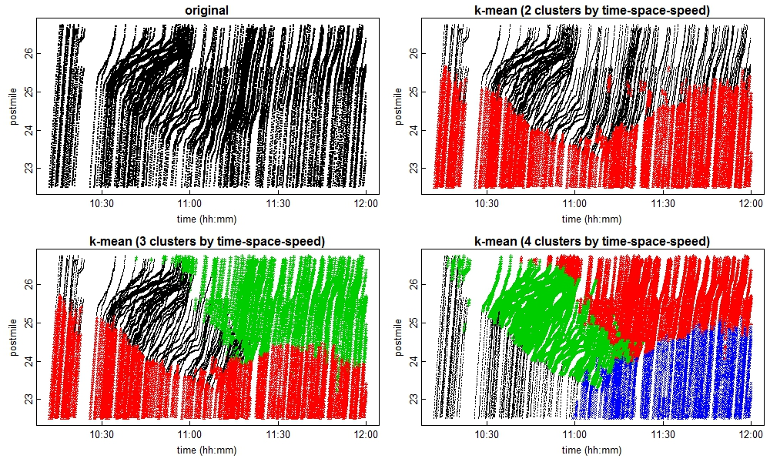
Future Work
Focus on congestion period
Utilize shockwave theory to identify additional traffic state
Other sites

Slide 17
Questions?
Funded by Mid-Atlantic Transportation Sustainability Center – Region 3 University Transportation Center

